Slide 1
AISC1003 Machine Learning I

Slide 2
Learning Outcomes – ML I – LR II – Gradient Descent
You will learn a new ML technique called Gradient Descent,
Understanding the derivation of where it comes from, and
How it compares to OLSR
You should appreciate different types of data
You will do a worked example of LR using GD

Slide 3
Recap –Last Class
Supervised ML concerns itself with Classification/Regression distinguished on a spectrum using labelled data
Learning occurs through an iterative process to build a model of underlying patterns
To do this we create some type of Objective (cost) Function we want to optimize, typically this comes as a trade off between factors such as Variance & Bias
One of the techniques, Regression, can inter/extrapolate values
To do this we create a derived model that minimizes Residuals

Slide 4
Exercises– Week 23
For the following data set, find/plot the fit, and the correlation using python & excel. Compare to Excel’s trendline. Plot the residuals, then rank them, notice anything.
Redo last week’s exercises properly. IF you have not already.
x | y | x | y | x | y
0 | 12.30257 | 10 | 106.9244 | 21 | 136.0519
1 | 20.1944 | 11 | 115.7368 | 22 | 160.7053
2 | 53.47424 | 12 | 74.14187 | 23 | 184.7324
3 | 60.52269 | 13 | 126.5221 | 24 | 152.8735
4 | 61.85855 | 14 | 119.9432 | 25 | 164.4765
5 | 70.42899 | 15 | 139.9098 | 26 | 169.6488
6 | 86.55053 | 16 | 133.7649 | 27 | 187.0767
7 | 54.28762 | 17 | 152.9818 | 28 | 174.1397
8 | 69.02268 | 18 | 157.5315 | 29 | 217.3314
9 | 100.4699 | 19 | 164.2307 | 30 | 198.0507
10 | 106.9244 | 20 | 130.2153

Slide 5
Exercises– Week 23
import pandas as pd
import numpy as np
import matplotlib.pyplot as plt
#Read excel file
df=pd.read_excel('exercises-wk2.xlsx')
#keep cols 2 and 3, rename columns per row 1, keep needed rows
df=df.iloc[:, 1:3]
df.columns = df.iloc[0]
df = df[1:32]
#slope, m=(Σy_{i}x_{i}-y̅_{i}Σx_{i})/(Σx_{i}²-x̅_{i}Σx_{i})
m=(sum(df["x"]*df["y"])-df["y"].mean()*sum(df["x"]))/(sum(df["x"] * df["x"])-df["x"].mean()*sum(df["x"]))
#b=y̅i-mx̅i
b=df["y"].mean()-m*df["x"].mean()
#Predictions
df["y_hat"]=df['x']*m+b

Slide 6
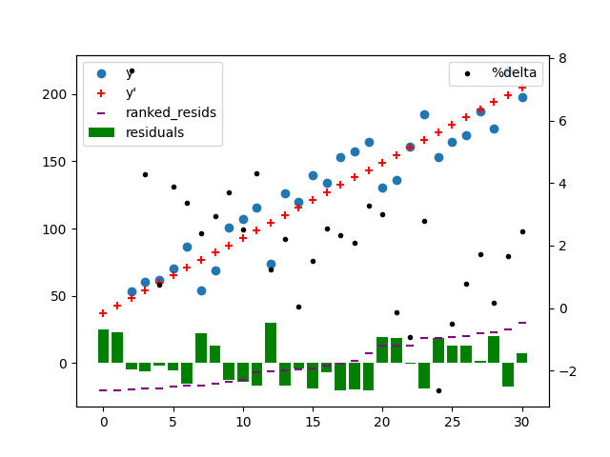
Exercises– Week 23
#Predictions
df["y_hat"]=df['x']*m+b
#residual analysis
df["residuals"]=df["y_hat"]-df["y"]
df["ranked_residuals"]=df["residuals"].sort_values(ascending=True).values
#df["temp"]=(df["ranked_residuals"]+abs(df["ranked_residuals"].head(1).item()))
df["%jump"]=(df["ranked_residuals"]+abs(df["ranked_residuals"].head(1).item())).pct_change()*100
#r^2
rsqr=sum((df["y_hat"]-df["y"].mean())*(df["y_hat"]-df["y"].mean()))/sum((df["y"]-df["y"].mean())*(df["y"]-df["y"].mean()))
print('m:',m,' b:',b," rsqr:",rsqr)
print(df)
#graph
fig=plt.figure()
ax1 = fig.add_subplot(111)
ax1.scatter(df['x'],df['y'], marker='o', label='y')
ax1.scatter(df['x'],df['y_hat'], marker='+', color="red", label="y'")
ax1.bar(df['x'],df['residuals'], width=0.8, color="green", label="residuals")
ax1.scatter(df['x'],df['ranked_residuals'], marker='_', color="purple", label="ranked_resids")
plt.legend()
ax2 = ax1.twinx()
ax2.scatter(df['x'],np.log(df['%jump']), marker='.', color="black", label="%delta")
ax2.legend(loc=0)
plt.show()

Slide 7
Assignment#0– Week 3?!
1. AI stands for Artificial Intelligence
2. Examples of AI that are NOT ML: rustic chatbots, old computer chess, rule-based Siri, IoT, solar lights,
Anti-lock braking system, some Google navigations,…
3. Typically, what is the underlying function we are trying to optimize in ML? Cost, price, objective.
4. What is the purpose of λ (lambda) in ML? To create a parameter with which we can easily find the optimal
balance between over and under fitting in a model. Balance bias vs. variance in fitting.
5. What is meant by deterministic in ML? A given input(s) leads to the same output(s). No random noise or
influencing factors.
6. Match the human-machine analogue (similar traits) pairs.
logic = rules
memory = databases
goals = optimization

Slide 8
Assignment#0– Week 3?!
7. What is the Turing Test used for? To test if a machine is Artificially Intelligent; can it be distinguished from a human?
8. What is the Turing Test? If human and computer outputs cannot be distinguished, the system is intelligent.
9. What is meant by a blackbox in ML?
When you are unable to determine why you got a certain result in ML. Blackbox is when
we get a result but we do not know the underlying logic that led to the result. Blackbox is
a concept in machine learning where the user does not have detailed knowledge of input
fuctionality but the ouput make sense. In a nutshell, why the result has happened by
applying ML model is not known but the model makes sense
10. How can we improve stochastic accuracy in Machine Learning? More data.
11. Define Machine Learning. The process by which a computer improves it’s ability to model using data,
without explicit secondary instructions.
12. How are DL & ML related? DL is a subset of ML; in particular it is one specific model in ML (the ANN or perceptron)
in which multiple intermediate layers exist between inputs and outputs.

Slide 9
Assignment#0– Week 3?!
13. If we can't tell if an entity (being) is thinking, what are two alternatives we can use as a proxy (representation)? Choices, actions/behaviours.
14. I have taken the Academic Integrity Module. True. (1 honest answer?)
15. Name an additional resource for getting help if you are struggling in class. Peer support, tutoring, ask professor, Linked in Learning…
16. What is the greatest barrier to success in this course?
Dishonesty, Poor time management, Failing to follow instructions.
17. Being 7 seconds late on an assignment … is okay as a reason for avoiding the late penalty.
False.
18. It doesn't matter how many times I email the professor, he/she/they must respond!
False.

Slide 10
Assignment#0– Week 3?!
19. During a testing scenario, your computer crashes. What is the correct sequence of events? Express your answer
as integer numbers without spaces e.g. 12345
153264
If you have another device, take a screenshot/picture, then a short video.
Note the time.
Reboot (turn off and on). Resume if you can.
Send all details to the instructor, outlining the problem.
Wait for instructions from the instructor.
If asked send all details to IT Support, and await their instructions.
20. A friend has been accused of committing academic dishonesty. What advice can you give them? Just tell the truth.
21. If the instructor has not stated otherwise on the assignment, I am free to use whatever materials I want. False. Consult the course default position? If there is none, ask!
22. I emailed Prof. 2 days ago, without response. I didn’t consult moodle, recordings, manual, nor put my student/course
#s. If I don't hear back by tomorrow I will have to make a complaint.
False!

Slide 11
Learning Outcomes – ML I – LR II – Gradient Descent
You will learn a new ML technique called Gradient Descent,
Understanding the derivation of where it comes from, and
How it compares to OLSR
You should appreciate different types of data
You will do a worked example of LR using GD

Slide 12
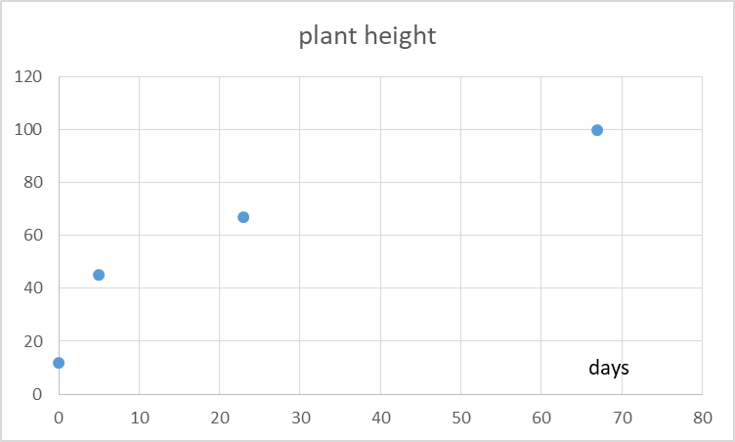
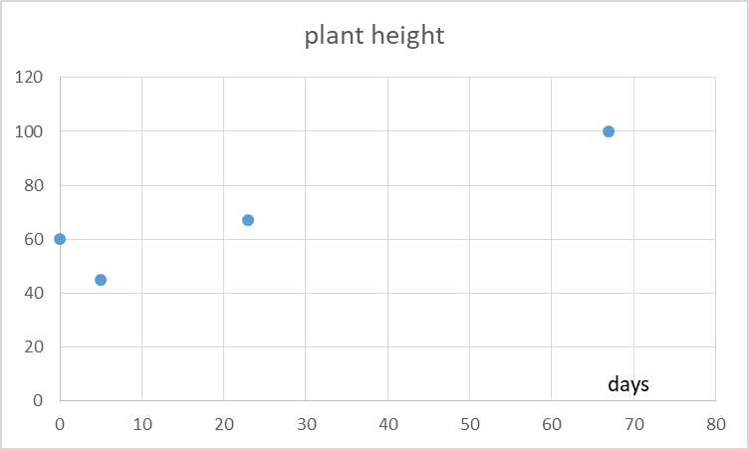
ML I –Linear Regression II – Gradient Descent
How do we INTERPOLATE?
How do we EXTRAPOLATE?

Slide 13
ML I –Linear Regression II – Gradient Descent
Plant growth rate
Given this dataset, we hypothesize there is a linear relationship.
Y = mX + b, Y,X are arrays
Y = (y₁, y₂,…, y_{n})
X = (x₁, x₂,…, x_{n})
Y ~ Y(x_{i})
Y(x_{i}) = mX + b
days
Size (mm)

Slide 14
ML I –LR II – GD –Design a cost function
Y(x_{i}) = mX + b
Choose m, b so that Y (x_{i}) is close to y_{i} for each data point.
}residual
y_{i}
Y(x_{i})
Cost Function:
J(m,b) = (1/n) Σ (Y(x_{i})-y_{i})²
Goal:
Minimize J(m,b)

Slide 15
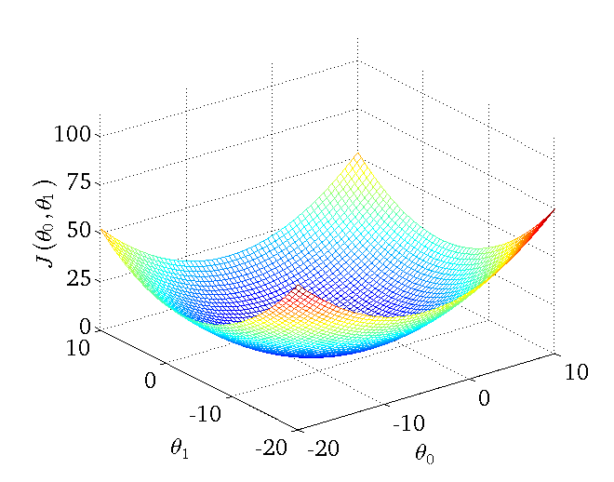
ML I –LR II – Gradient Descent –Minimize Cost
Cost Function typically looks like this.
J(m,b) = (1/n) Σ (Y(x_{i})-y_{i})²
m b
Goal:
Minimize J(m,b)
Method:
Start with some m₁, b₁
Keep changing m & b to reduce J until we
hopefully end up at a minimum

Slide 16
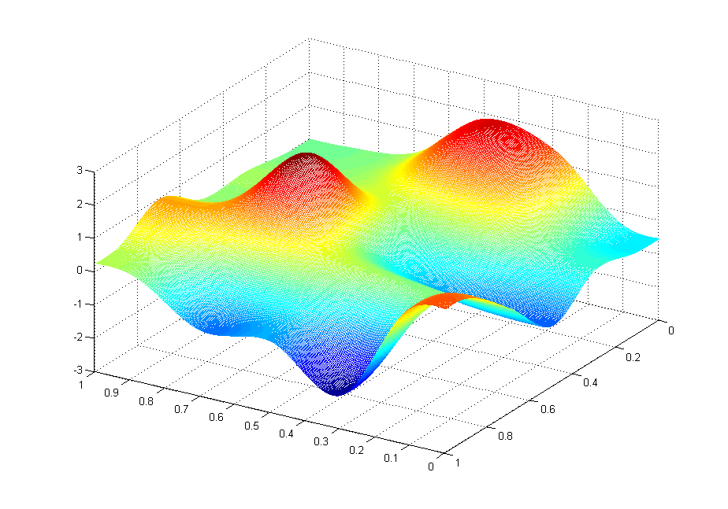
ML I –LR II – GD –Local vs Global Extremum
There may be more than one path:
What does this look like mathematically?

Slide 17
ML I –Linear Regression II – Gradient Descent
The gradient is simply the SLOPE of the surface.
It is the sensitivity to the parameters in question.
It is the partial derivative with respect to the inputs.
J(m,b)₂ = J(m,b)₁ -α ∇ J(m,b)_{1 ,} ∇= gradient,
α= rate of approach

Slide 18
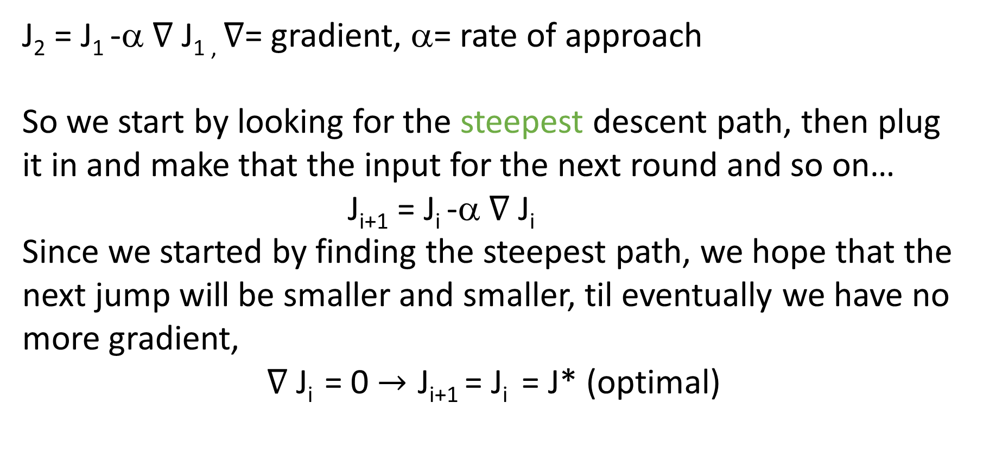
ML I –Linear Regression II – Gradient Descent
J₂ = J₁ -α ∇ J_{1 ,} ∇= gradient, α= rate of approach
So we start by looking for the steepest descent path, then plug it in and make that the input for the next round and so on…
J_{i+1} = J_{i} -α ∇ J_{i}
Since we started by finding the steepest path, we hope that the next jump will be smaller and smaller, til eventually we have no more gradient,
∇ J_{i} = 0 $→\text{J}$_{i+1} = J_{i} = J* (optimal)

Slide 19
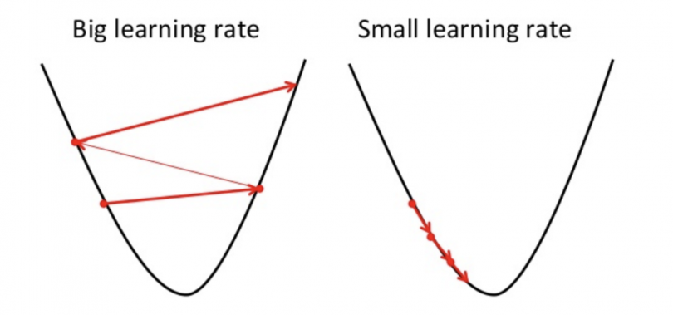
ML I –Linear Regression II – Gradient Descent
J₂ = J₁ -α ∇ J_{1 ,} ∇= gradient, α= rate of approach
If α is too small, the gradient descent will be small and slow (small steps). If it is too big, it will leap over the local minimum and jump out of the area of the curve:

Slide 20
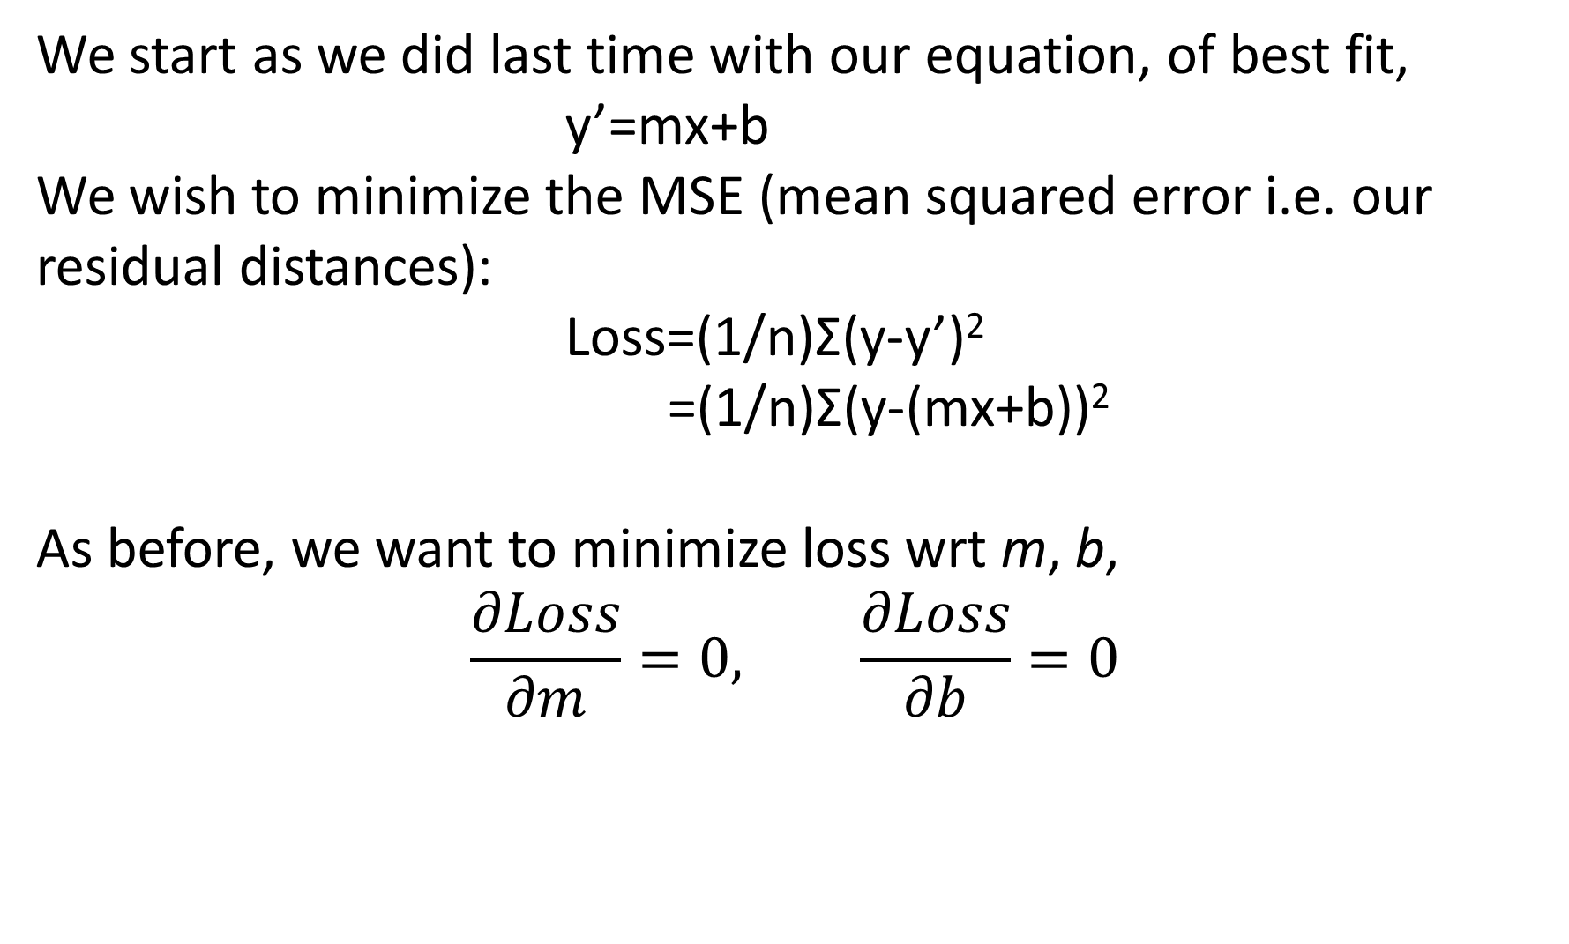
ML I –Linear Regression II – Gradient Descent
We start as we did last time with our equation, of best fit, y’=mx+b
We wish to minimize the MSE (mean squared error i.e. our residual distances):
Loss=(1/n)Σ(y-y’)²
=(1/n)Σ(y-(mx+b))²
As before, we want to minimize loss wrt m, b,
$$\frac{∂Loss}{∂m}=0, \frac{∂Loss}{∂b}=0$$

Slide 21
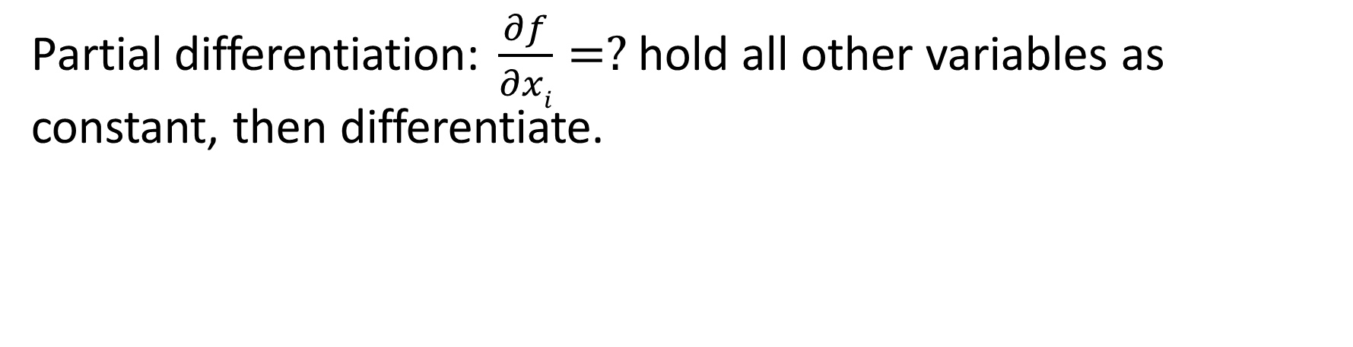
ML I –Linear Regression II – Gradient Descent
Partial differentiation: $\frac{∂f}{∂xi}=?$ hold all other variables as constant, then differentiate.

Slide 22
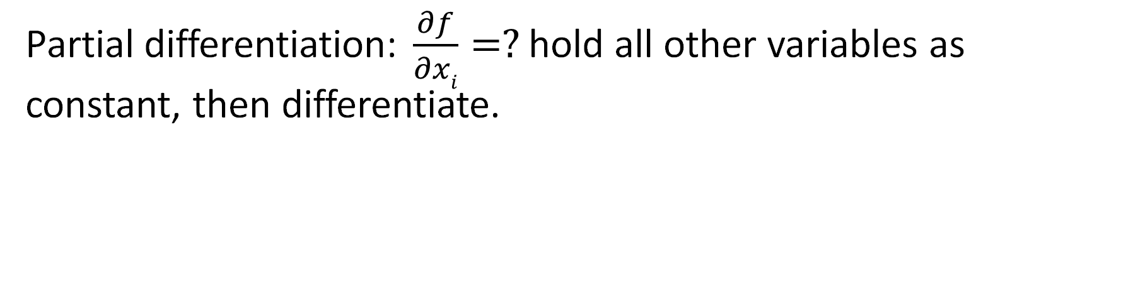
ML I –Linear Regression II – Gradient Descent
Partial differentiation: $\frac{∂f}{∂xi}=?$ hold all other variables as constant, then differentiate.

Slide 23
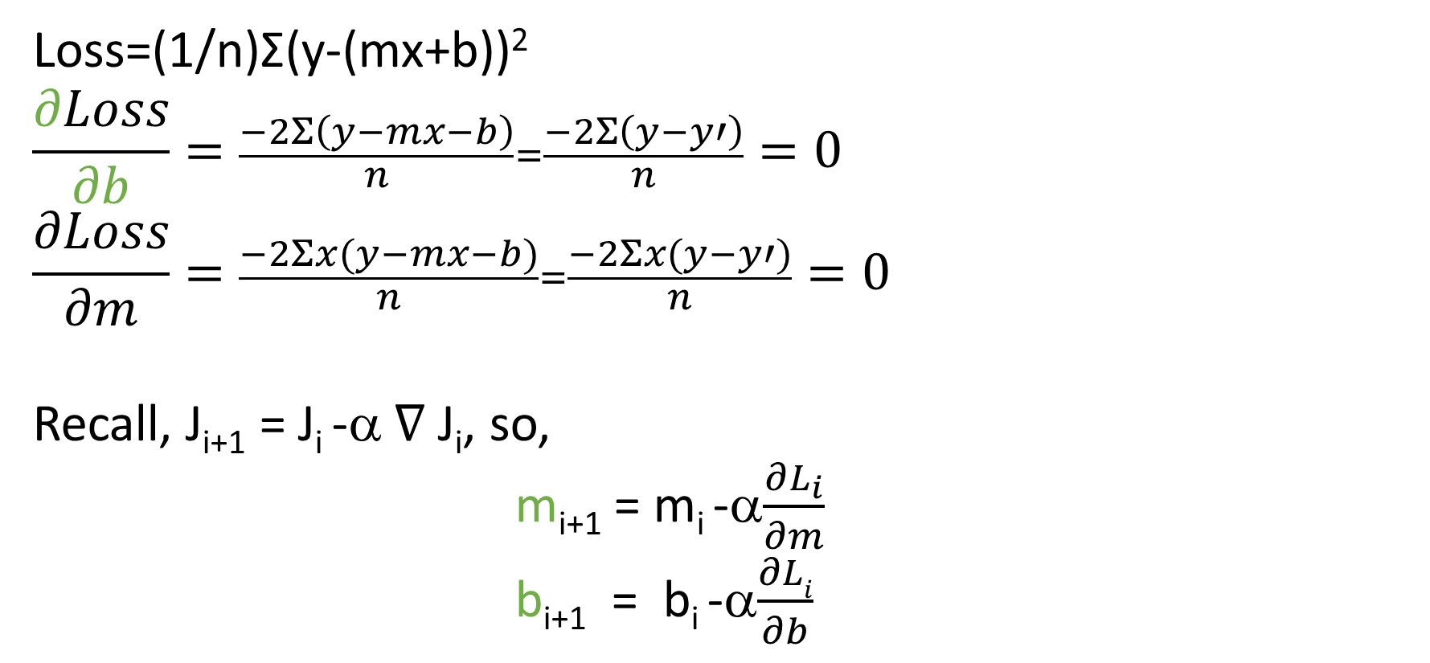
ML I –Linear Regression II – Gradient Descent
Loss=(1/n)Σ(y-(mx+b))²
$$\frac{∂Loss}{∂b}=\frac{−2Σ\left(y−mx−b\right)}{n}=\frac{−2Σ\left(y−y′\right)}{n}=0$$
$$\frac{∂Loss}{∂m}=\frac{−2Σx(y−mx−b)}{n}=\frac{−2Σx(y−y′)}{n}=0$$
Recall, J_{i+1} = J_{i} -α ∇ J_{i}, so,
m_{i+1} = m_{i} -α$\frac{∂L_{i}}{∂m}$
b_{i+1} = b_{i} -α$\frac{∂Li}{∂b}$

Slide 24
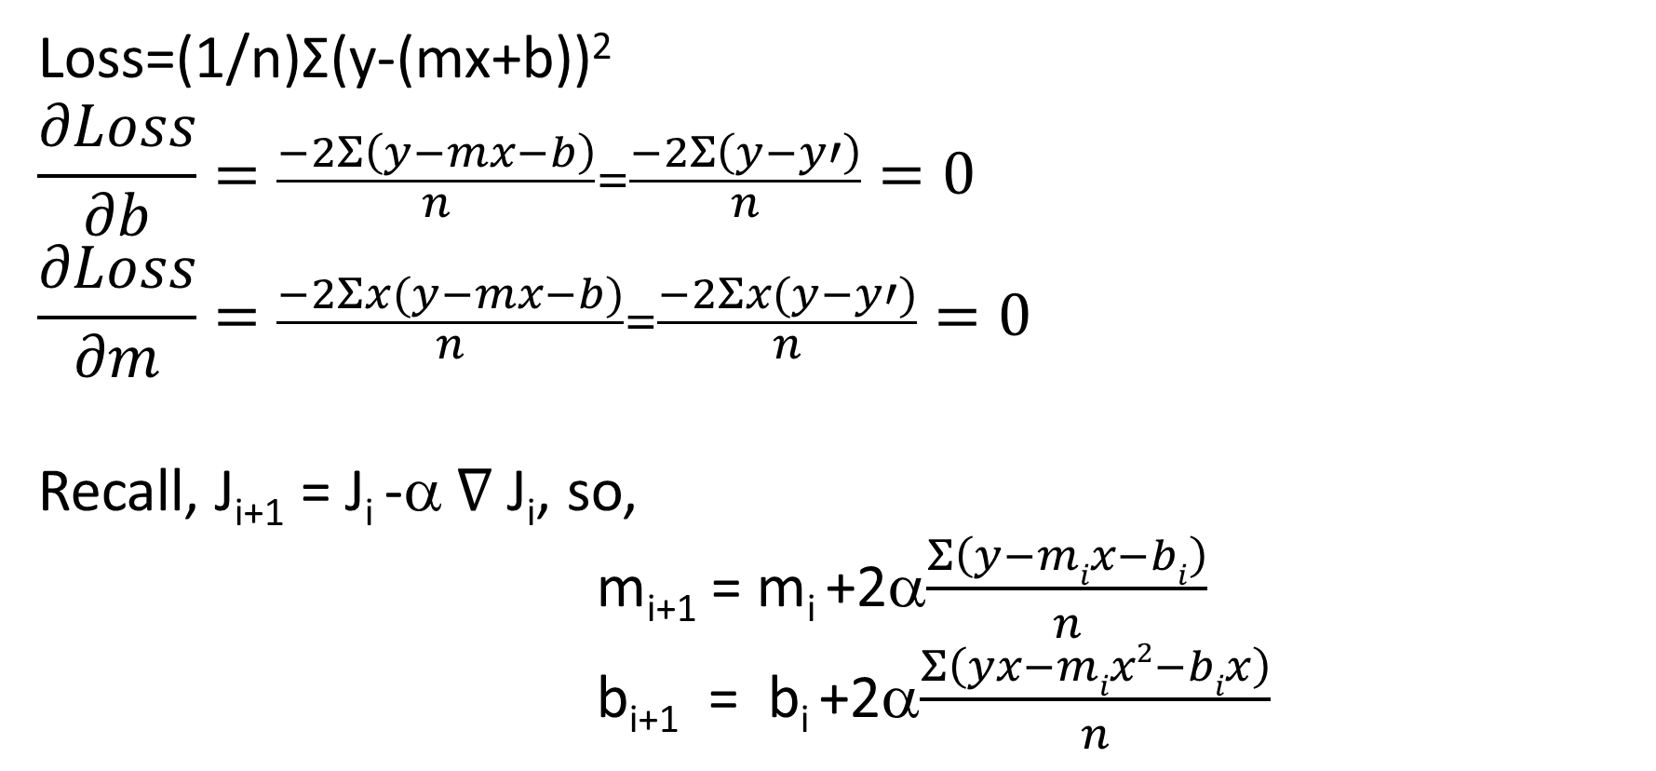
ML I –Linear Regression II – Gradient Descent
Loss=(1/n)Σ(y-(mx+b))²
$$\frac{∂Loss}{∂b}=\frac{−2Σ\left(y−mx−b\right)}{n}=\frac{−2Σ\left(y−y′\right)}{n}=0$$
$$\frac{∂Loss}{∂m}=\frac{−2Σx(y−mx−b)}{n}=\frac{−2Σx(y−y′)}{n}=0$$
Recall, J_{i+1} = J_{i} -α ∇ J_{i}, so,
m_{i+1} = m_{i} +2α$\frac{Σ\left(y−mix−bi\right)}{n}$
b_{i+1} = b_{i} +2α$\frac{Σ\left(yx−mix2−bix\right)}{n}$

Slide 25
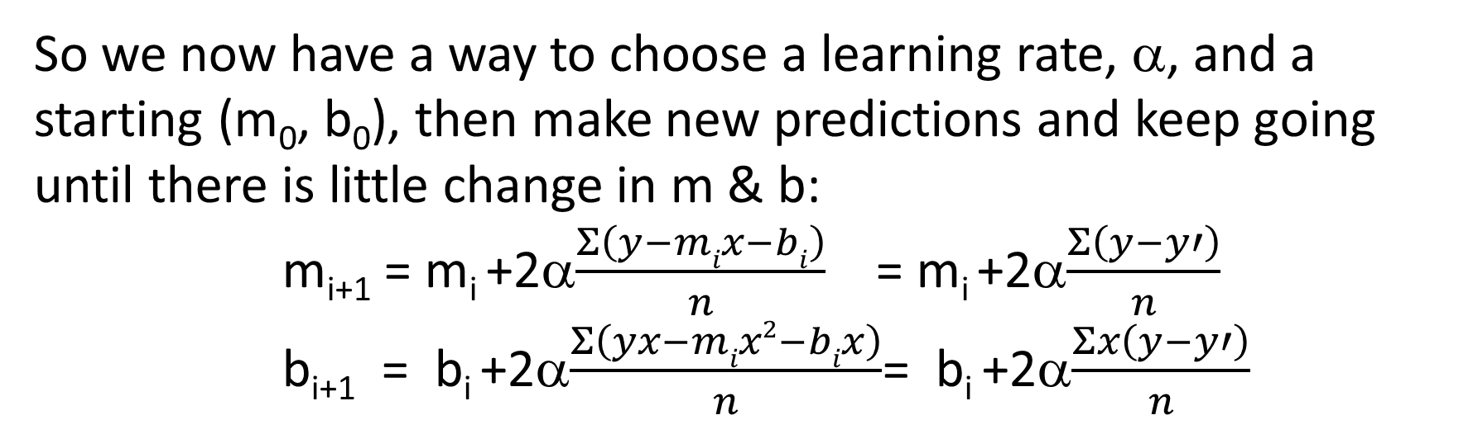
ML I –Linear Regression II – Gradient Descent
So we now have a way to choose a learning rate, α, and a starting (m₀, b₀), then make new predictions and keep going until there is little change in m & b:
m_{i+1} = m_{i} +2α$\frac{Σ\left(y−mix−bi\right)}{n}$ = m_{i} +2α$\frac{Σ\left(y−y′\right)}{n}$
b_{i+1} = b_{i} +2α$\frac{Σ\left(yx−mix2−bix\right)}{n}$= b_{i} +2α$\frac{Σx\left(y−y′\right)}{n}$

Slide 26
ML I –Linear Regression II – Gradient Descent
We have applied the principles of LR using GD in a haphazard manner, making several assumptions that are not necessarily always met. This means we can apply GD and get results that look meaningful, but may not actually apply.
AI ≠ AISC
Assumptions can be weak or strong, they can be mitigated.

Slide 27
ML I –Linear Regression II – Gradient Descent
1. Linearity
The underlying relationship is LINEAR!
-slope doesn’t depend on other variables
-other variables can each have an additive effect
-failure out of range can easily exist, even if ok in range
2. Independence:
Data is UNCORRELATED
-failure (e.g. auto-correlation lag) can result in skewed fits (under/overfitting in some regimes)

Slide 28
ML I –Linear Regression II – Gradient Descent
Errors (residuals) follow a Normal Distribution
-failure couId be data is not truly linear or have outliers
-failure could mean unexplained influencing variables
-failure could make prediction intervals very weak
Homoscedasticity:
Errors have similar variance (no progression)
-failure could lead to skewed weighting of some data
-failure can cause poor estimation

Slide 29
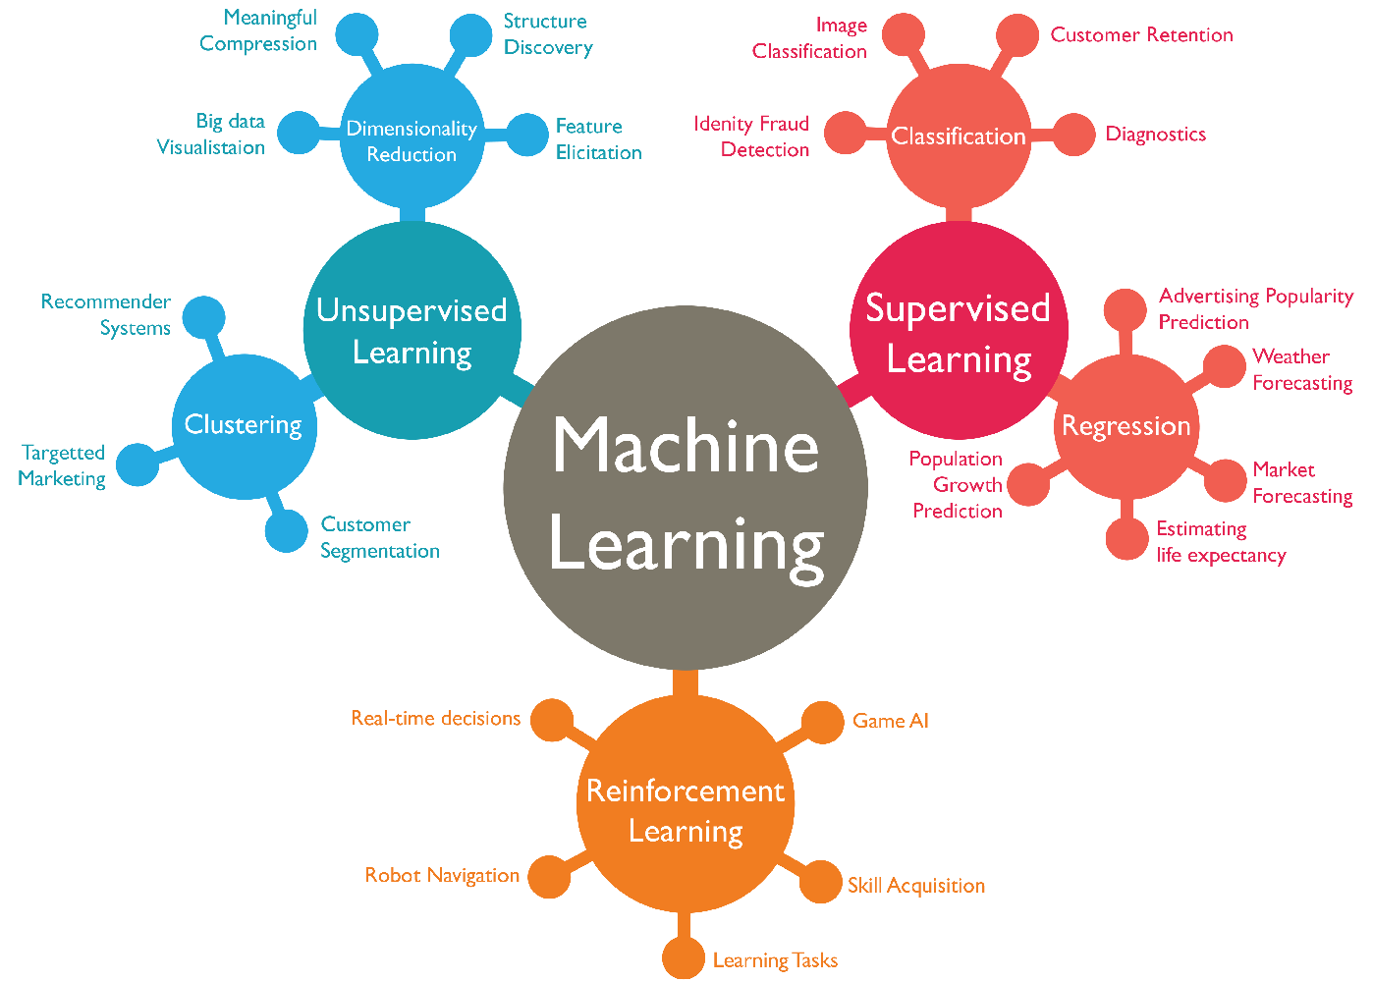
MLI – Supervised Problems
Semi-supervised Learning
Reinforcement Learning

Slide 30
ML I – Supervised vs Unsupervised learning
-without supervision
-less data requirements (labelling)
-Clustering/Association & Dimensional Regression
-machine is learning by discovering structure/patterns
machine is learning with the aid of supervision-
supervision = training, “labelled” data-
machine learns until it doesn’t have to-
Classification & Regression-

Slide 31
MLI – Supervised Problems
-define objective function and measure fit/prediction ‘price’
-optimize that function
-there are trade-offs in the process
-balancing those trade-offs often lead to the best models
So exactly where is the training?!

Slide 32
MLI – Supervised Problems -Training
As we saw before, we need to validate our fits using the data.
In this example of cross-validation, we ran our model against all parameter-combinations to get the best one:
Goal: minimize loss by compromising (balance fitting)
J(λ) = RMSE + λRegularization(weights)

Slide 33
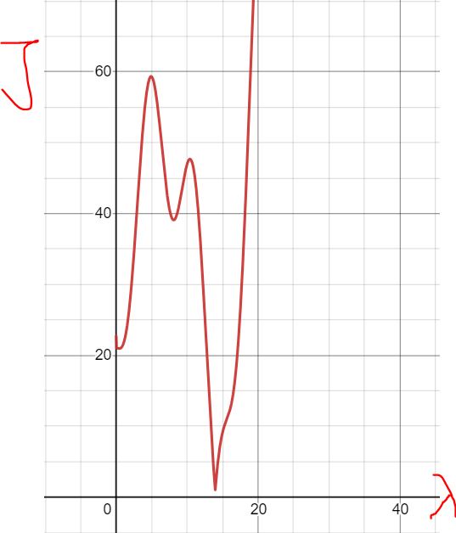
MLI – Supervised Problems -Training
Minimize:
J(λ) = RMSE + λRegularization(weights)
This is an example of hyperparameter tuning
λ is not really a part of the analytical problem, but it leads to an optimal solution.
It is a parameter, outside/above the model.
So where else have we seen learning
going on via a hyperparameter?

Slide 34
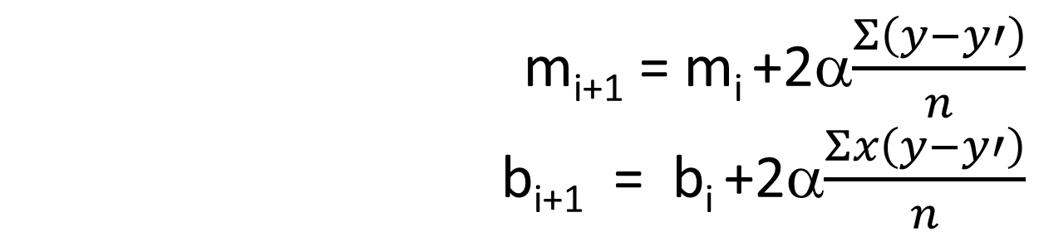
MLI – Supervised Problems -Training
Recall: α = Learning rate in GD
m_{i+1} = m_{i} +2α$\frac{Σ\left(y−y′\right)}{n}$
b_{i+1} = b_{i} +2α$\frac{Σx\left(y−y′\right)}{n}$

Slide 35
MLI – Supervised Problems -Training
But there is a problem with using our data exclusively.
We have fit our model. We may even have found a good fit.
But after that, then what?!
We have no predictive power.
There are other methods to determine goodness of fit:
One method is to train our model with only some of our data, then see how well it predicts the rest of our data.

Slide 36

MLI – Supervised Problems -Training
We usually split our data into three categories that are usually separated:
Training data -the data used to make our initial model
Validation data -the data used to see if our model is good, and to tune it using the method of hyperparametrization
Testing data -the final test of a tuned model is undertaken on this set

Slide 37
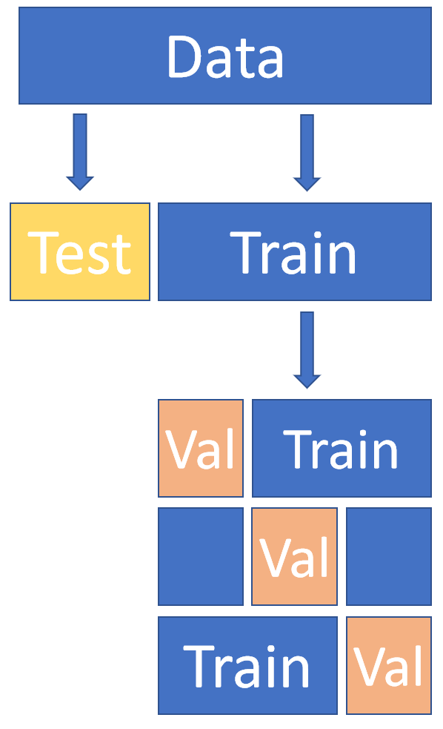
MLI – Supervised Problems -Training
There are many, many different ratios, and schemes
that can be used to split the data.
How much data is available?
Is it sequential?
Is it all of the same quality?
How many hyperparameters are there?
How sensitive is the model?
How much data does the model need?

Slide 38
Exercises –Week 4
Using the same dataset from Week 2, perform Linear Regression by Gradient Descent using Excel & Python.
Compare results to Week 2 using OLS.
How well does Excel fare, compared to Python? What are the pros and cons of each?
Play with the tuning parameters and see how that affects your metrics, as well as plotting efficiency.
Is there a threshold value for alpha that is optimal?
What method is better?

